Slide 1
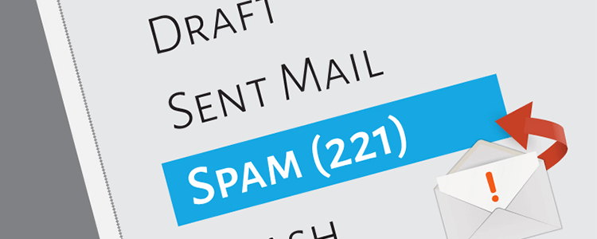
BI Final Project:
Model Improvement using GridSearchCV for
Spam Email Prediction
Viona Zatil Aqmar Kaleb (001202207001)
MSIT

Slide 2
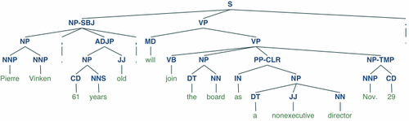
Introduction
In this project, text processing is carried out using NLTK, which involves tokenization, removing non-alphabetic characters, and eliminating common English stopwords.
For the final, I did experiment with hyper parameter tuning for the chosen classifier to help finding the optimal parameters for the model.

Slide 3
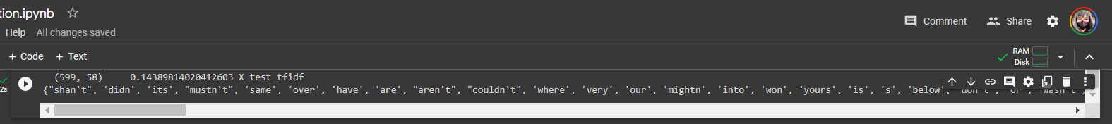
Additionally, the Term Frequency-Inverse Document Frequency (TF-IDF) vectorization technique is used to transform the preprocessed text into numerical features.
For email classification, a Multinomial Naive Bayes classifier is selected and trained using the TF-IDF-transformed features on the training data.

Slide 4
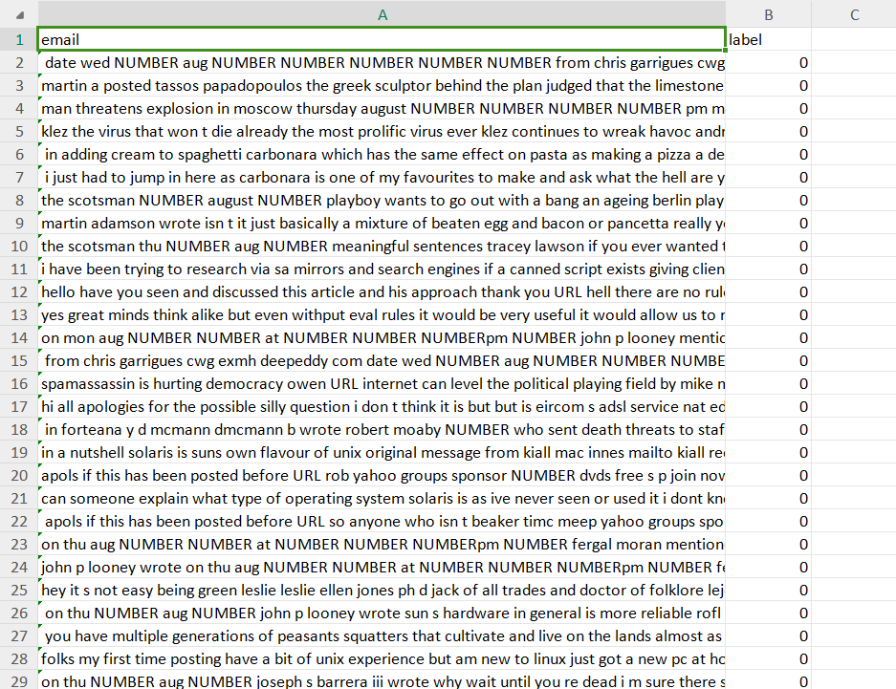
Dataset
The dataset was retrieved from https://spamassassin.apache.org/old/publiccorpus/ i.e. Apache SpamAssassin’s public datasets.
There are 2500 ham and 500 spam emails in the dataset. All the numbers and URLs were converted to strings as NUMBER and URL respectively. This is the simplified spam and ham dataset.
Data label 1 indicates spam, while 0 indicates non-spam email.

Slide 5
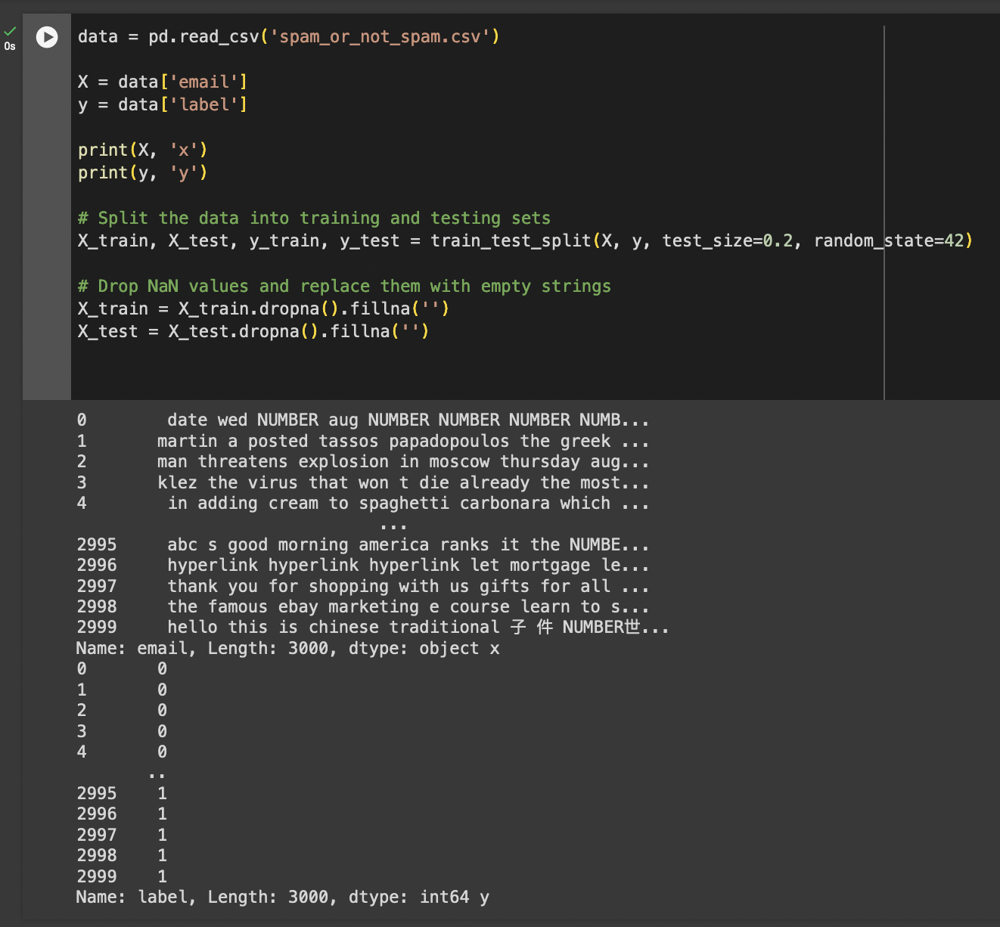
Data Source
The project starts by loading email data from a CSV file named 'spam_or_not_spam.csv'.
This dataset likely contains a collection of emails along with labels indicating whether each email is spam (1) or not spam (0).

Slide 6
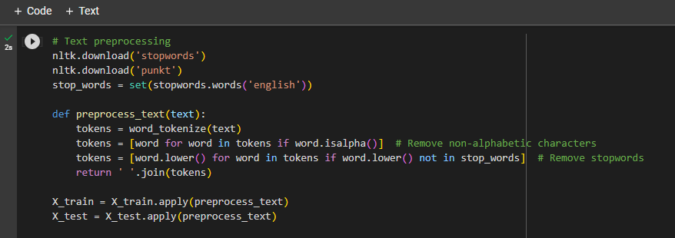
2. Text Preprocessing
The email content is preprocessed to prepare it for machine learning. This includes tokenization (splitting text into words), removal of non-alphabetic characters, and eliminating common English stopwords (e.g., "and," "the," "is").
These steps help clean and normalize the text data.

Slide 7
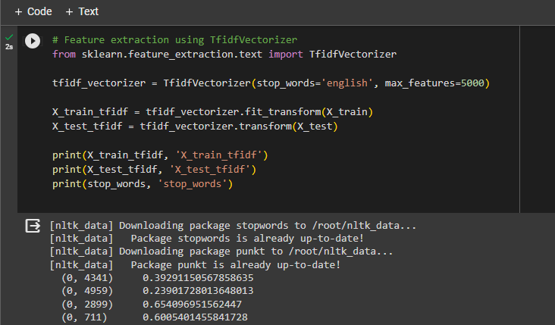
3. Feature Extraction
The code uses the TF-IDF (Term Frequency-Inverse Document Frequency) vectorization technique to convert the preprocessed text data into numerical features.
TF-IDF assigns numerical values to words based on their importance within each document and across the entire dataset. It helps in converting text data into a format suitable for machine learning.

Slide 8
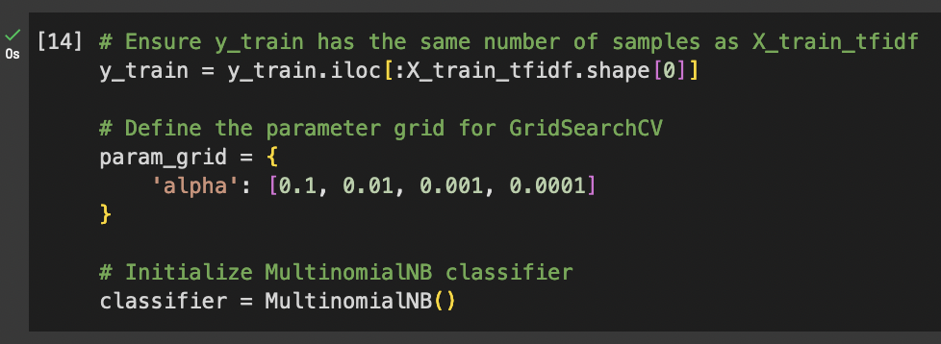
3. Classification Model (Improvement)
The project employs a Multinomial Naive Bayes classifier, a common choice for text classification tasks.
First I ensure y_train has the same number of samples with X_train_tfidf.
Then defining the parameter grid for GridSearchCV before initializing the MultinomialNB classifier.

Slide 9
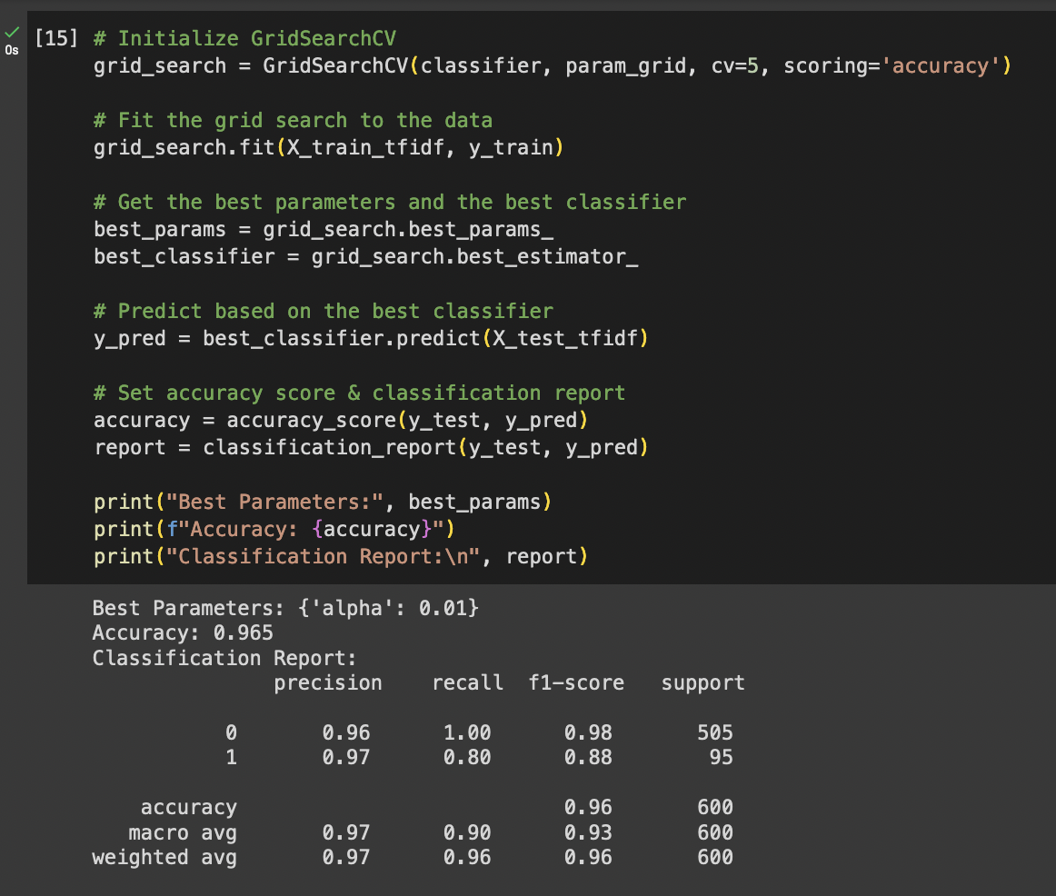
4. Improved Prediction and Evaluation
The accuracy of the improved model is 96.5%
(before was 88.5%)
This code utilizes GridSearchCV to optimize the hyperparameters of a Multinomial Naive Bayes classifier for spam email prediction.
The grid search explores different alpha values for Laplace smoothing using a five-fold cross-validation setup, aiming to maximize accuracy. Then after fitting the grid search to the training data, it extracts the best hyperparameters and the corresponding best classifier, which is 0.01.

Slide 10
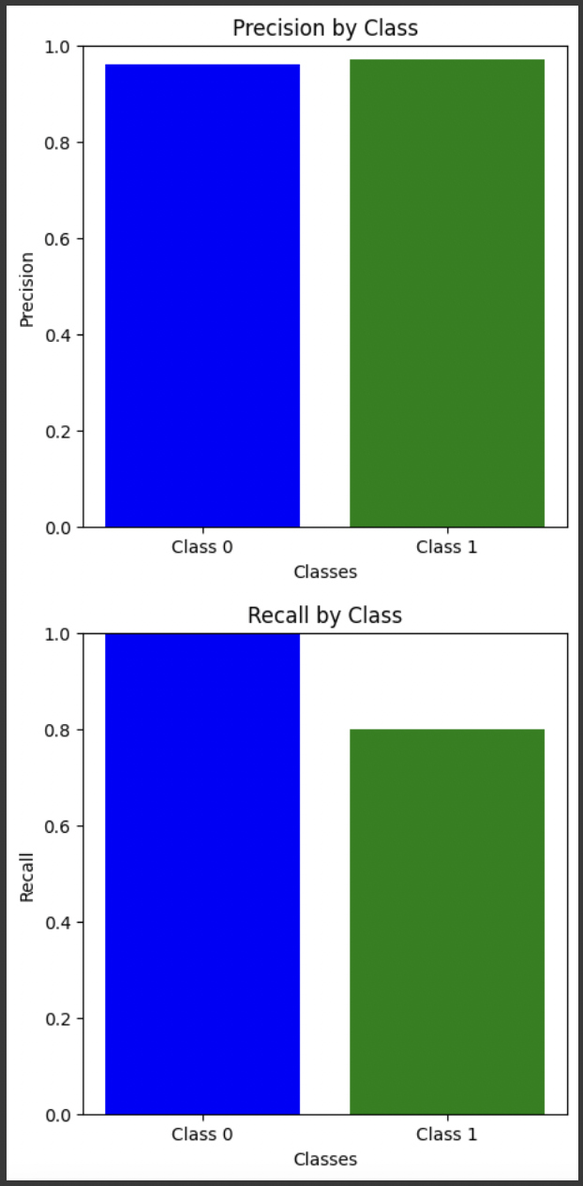
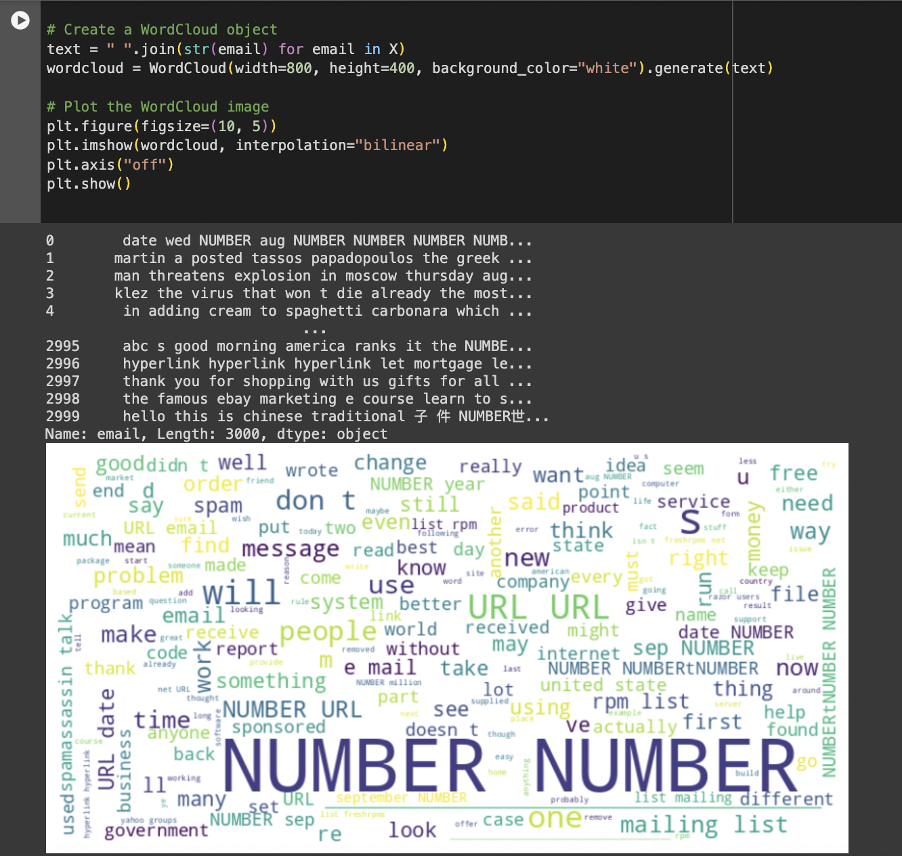
5. Visualization
The project includes visualizations to help users understand the performance of the model.
Word Cloud is generated to create a visual representation of the most common words in the entire email dataset. This can provide insights into the types of words that are prevalent in spam and non-spam emails.
‘NUMBER’ and ‘URL’ are the most frequent words appeared.

Slide 11
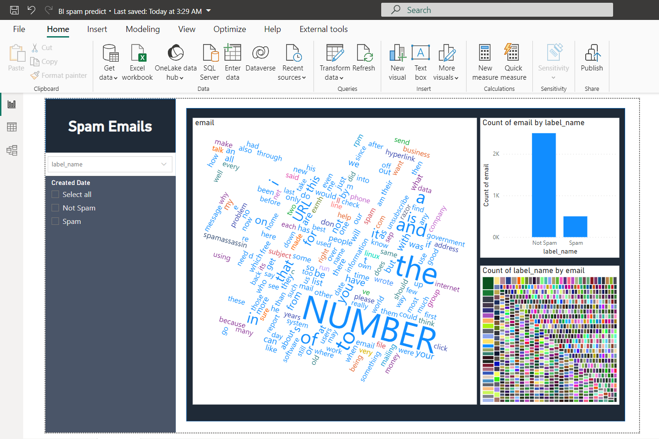
6. Power BI
Visualization
Power BI is also implemented to process and visualize the data.
Slicers, word cloud, bar chart, and treemap are used to identify which term appears frequently.
In Power BI, ‘NUMBER’ and ‘URL’ are still the most frequent words appeared.

Slide 12
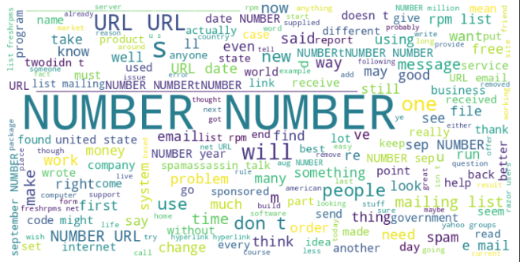
Conclusion
The accuracy of the improved model is 96.5% .
(Before was 88.5%).
The improvement of the code is using GridSearchCV to automate the process of hyper-parameter tuning, model training, and performance evaluation for the task of spam email classification. And the best ‘alpha’ hyper-parameters and the corresponding best classifier is 0.01.

Slide 13
Files
Viona Z A Kaleb - 001202207001
https://drive.google.com/drive/folders/1SeZxvDAJEYW711-xaHkIzXcda1xT4i8j?usp=sharing
Also available on Github: https://github.com/vionakaleb/-business-intelligence-final

